Slide 1
Back Against WallStreet

Slide 2
Current Scope
Login Page is complete
Sign Up Page is complete
The user is allowed to switch from the login page to the sign up page.
Database Functionality using CSV Files
Access to Yahoo Finance API

Slide 3
Current Schedule
Accomplishments:
Login feature front and back end
Sign up Feature Front and back end
Home page front and back end
User data table and file
Connection between Login and Sign Up
Connection to Yahoo Finance API
Not Achieved:
Two Tests
Connection between front and back end of home page
Advanced input validation on login and sign up

Slide 4
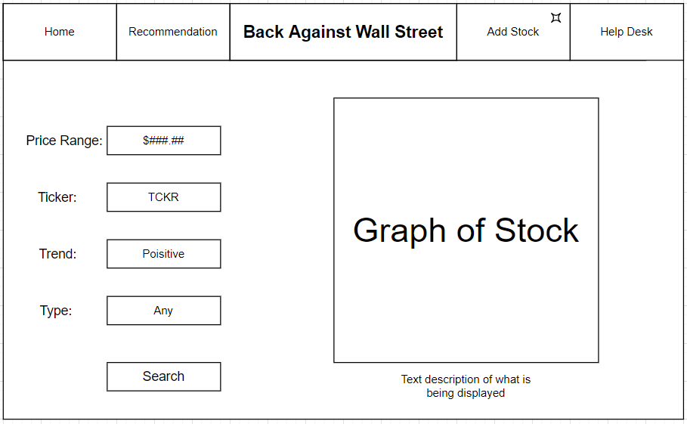
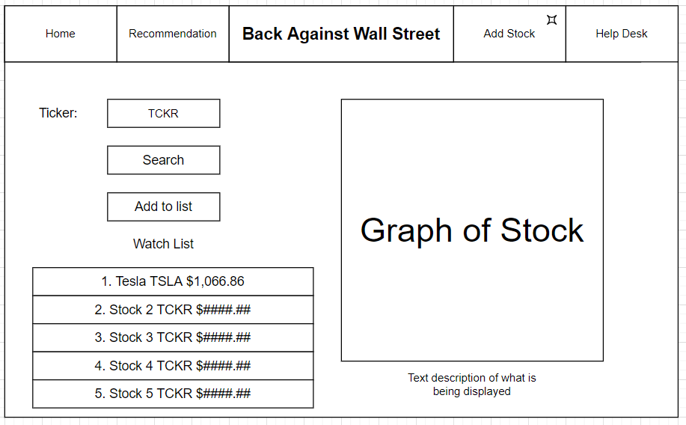
Sprint 2 Plans
Continue to build out home page feature
Complete 3.2.2.3.1 REQ-1 list of stocks
Prototype 3.2.2.3.2 REQ-2 test check boxes
Build Stock Recommendation feature
Complete 3.2.5.3.1 REQ-1 Basic Stock Recommendation
Build Stock addition Feature
Complete 3.2.5.3.2 REQ-2 Augmented Stock Recommendation

